Slide 1
Making this resource work for you
Prior to teaching this lesson, please refer to the ‘Unit Overview and Planning Document’.
Further guidance on planning Science Mastery lessons can be found in the detailed planning guidance document.
Refer to the ‘notes’ section on each slide for useful information, including suggested expositions, pedagogical content knowledge, suggested questions, answers and more. Consider using presenter mode so you can see this guidance throughout the lesson.
The introduction slides can be adapted to suit your teaching style and the needs of your class.
Before the lesson, adapt the fix-it slide to address any misconceptions identified in the previous lesson’s exit ticket.
Choose from the suggested activities to suit your class. The intention is not that you complete all of these, but that you select those which ones are most appropriate for your students. It may be appropriate to further adapt activities for your students.
These lessons are designed to occupy approximately 1 hour. To adapt for a shorter or longer lesson duration we advise you to adapt the activity section accordingly.
Please consider using the final slide to send feedback about this lesson or examples of PowerPoints that you have adapted to our design team. Your feedback is used to improve Science Mastery for all of our teachers and students. We appreciate all suggestions and comments.
Thank you for reading!
The Science Mastery Team

Slide 2
Feedback Lesson
Answer the questions below:
State the definition of biodiversity.
State the approximate biomass efficiency between trophic levels.
State two consequences of global warming.
Explain why energy is lost between trophic levels in a food chain.
Identify a way individuals can improve food security.
The variety of different species in an ecosystem.
10 %
Melting ice caps, rising sea levels, flooding, extreme weather patterns, loss of habitats, change to migration patterns
Some biomass is lost as waste (urine, faeces, sweat etc) and some is used for life processes, such as movement, growth and thermoregulation.
Reduce their meat intake/eat more food from producers, eat seasonally and locally.
Notes:
Purpose: to assess learning from previous lessons.
Foundation question: State the name of a greenhouse gas that contributes to global warming.
Answer: carbon dioxide, methane
Stretch question: Explain what is shown by a pyramid of biomass and explain why it always has roughly the same shape.
Answer: pyramids of biomass show a representation of the amount of organic material at each trophic level. It is always pyramidal shaped because energy/biomass transfer is only approximately 10% as the rest is lost through waste and life processes (movement and thermoregulation).

Slide 3
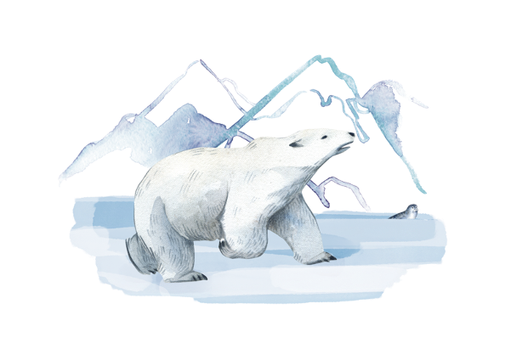
B3.2.10
18/09/2024
Feedback Lesson
B3.2.1 Prior Knowledge Review
B3.2.2 Biodiversity
B3.2.3 How Humans Affect Biodiversity
B3.2.4 How Humans can Preserve Biodiversity
B3.2.5 The Effect of Pollution on Biodiversity
B3.2.6 Global Warming
B3.2.7 Taking It Further: Pyramids of Biomass
B3.2.8 Taking It Further: Farming and Biotechnology
B3.2.9 Taking It Further: Food Security

Slide 4

Following this lesson, students will be able to:
State…
Describe…
Explain…
Key Words:
food chain
efficiency
producer
biodiversity
biomass
ecosystem
Notes:
Can be edited depending on desired outcome following mastery quiz performance.

Slide 5
This is the fix-it portion of the lesson
The fix-it is an opportunity to respond to gaps in knowledge, especially those identified by the previous lesson’s exit ticket.
The teacher should customise this slide as needed, to facilitate
reteach, explanation, demonstration or modelling of ideas and concepts that students have not yet grasped or have misunderstood.
practise answering specific questions or of key skills.
redrafting or improving previous work.
Notes:
Purpose: to spend time on any gaps identified in previous learning from mastery quiz.

Slide 6
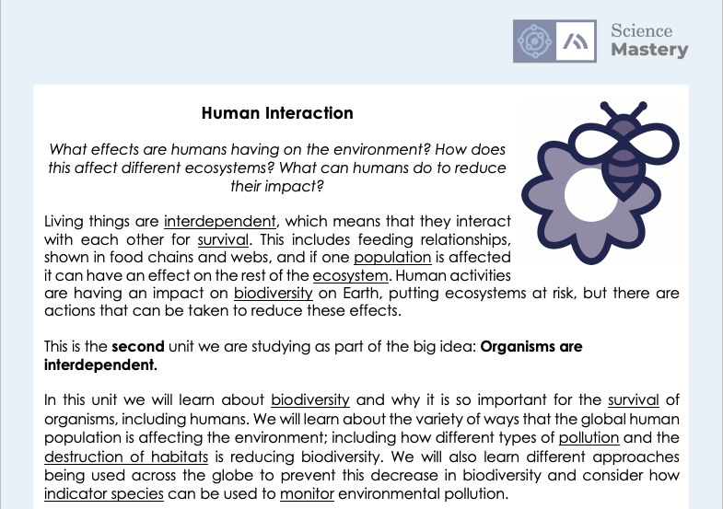
The Big Idea: Organisms are interdependent
Notes:
Purpose:. The purpose of this resource is to provide students with an overview at the beginning and end of each unit. It is designed to create a discussion about the unit prior to and at the end of the sequence of lessons.
Teacher guidance:
Pupils should be directed to the B3.2 Link to Big Ideas worksheet (either in their booklet or printed). This may be back at the beginning of the sequence of lessons.
Teachers should use guided reading techniques to read aloud with the pupils and then pupils should answer the reflection questions. This could be used to summarise what pupils have learnt.
Questions on the student sheet:
1. Tick off any words in the ‘words I haven’t seen before’ column that you are now confident with. Circle any you still need more practice to use.
2. What have you most enjoyed about this unit?
3. What more would you like to learn about particles as part of the big idea: ‘organisms are interdependent’?
There are a range of ways to use this resource:
1. Display on a slide for students to read as a class. Direct students to complete the activities in their book.
2. Print off for students to stick into their book at the beginning of the unit along with their knowledge organiser. Complete as a guided reading task together. Direct students to complete the activities.
3. Have students complete as part of a booklet.
Set as a homework to reflect on the unit.
If you have any feedback about how this resource could be used/improved, please contact the science mastery team: sciencemastery@arkonline.org

Slide 7

Answers
Question | Answer
1
2
3
4
5
6
7
8
9
10
11
12
13
14
15
C
C
C
C
B
A
B
B
A
A
A
B
C
A
B
Notes:
Purpose: for students to correct their answers so they can see where they made errors and have a corrected quiz stuck in their books
Suggested guidance: talk through each question and cold call students to explore why the incorrect options are wrong. Students should write annotations on their marked quiz so they can revise from it.

Slide 8
Answers
A quadrat provides a known area in which to count the number of individual organisms.
Any one from:
Humans reduce the amount of land available for biodiversity by:
Building
Deforestation
Quarrying
Farming
Waste disposal
Growing biofuels
Destruction of peat bog habitats to extract the peat for compost, which is used for farming and gardening.
Introducing non-indigenous species that can reduce biodiversity if the species out-competes or kills indigenous species.
Notes:
Purpose: for students to correct their answers so they can see where they made errors and have improved their Section B answers.
Suggested guidance: talk through each question and cold call students to explore why the incorrect options are wrong. Students should write annotations on their marked quiz so they can revise from it.

Slide 9
Answers
Data must be measured regularly because it provides evidence for answering the scientific question about how global atmospheric temperature is changing.
Notes:
Purpose: for students to correct their answers so they can see where they made errors and have improved their Section B answers.
Suggested guidance: talk through each question and cold call students to explore why the incorrect options are wrong. Students should write annotations on their marked quiz so they can revise from it.

Slide 10
Answers
4.
A meat-alternative diet is more sustainable that a meat-based diet because the carbon foot print of tempeh, tofu and Quorn is less than beef. For example, the carbon footprint of tempeh and tofu is 0.7 kg CO2 / year / kg, whereas beef is 32 kg CO2 / year / kg. This means that these meat-alternatives contribute less to global warming compared to meat.
Tofu and Quorn have land use of less than 5 m2 / kg whereas beef uses 325 m2 / kg. The greater land use of beef reduces biodiversity because land is turned into farmland for cows, rather than a habitat for indigenous species.
To ‘explain’ your answer should:
Begin with a scientific statement.
Use ‘this means that’, ‘because’ or ‘so’ to link your statement to the question. and then they should peer assess each other’s answers using this.
Notes:
Purpose: for students to correct their answers so they can see where they made errors and have improved their Section B answers.
Suggested guidance: talk through each question and cold call students to explore why the incorrect options are wrong. Students should write annotations on their marked quiz so they can revise from it.

Slide 11

Think outside the box!
What effect will global warming have on biodiversity and food security?
What is global warming?
What are the consequences of global warming?
What is biodiversity?
Why would this be affected?
What is food security?
Why would this be affected?
Notes:
Guidance:
Giving pupils an opportunity to link to the big idea of this topic, that organisms are interdependent (and this includes humans).
Questions are suggestions, can be edited depending on the amount of structure you want to give pupils.
Suggested guidance:
Talk tasks can be used in a variety of ways to suit the particular needs of the students you are teaching. Through exchanging views with others, students develop their understanding of the science beyond what could be achieved individually.
Science classrooms that successfully integrate talk have the following features:
Science talk is a regular feature of lessons and is woven into classroom activities.
Students are paired or grouped strategically by the teacher to ensure productive interaction. This might take into consideration the students’ proficiency of the English language, how encouraging they might be to peers and their attainment in the topic. It’s a good idea to consider these pairings in the class seating plan.
Students are encouraged and supported to talk, but are not forced to talk.
The teacher should take on the role of a facilitator, engaging with conversations where necessary and encouraging or steering the conversation where needed.
Students are encouraged to use the language they have to express their ideas (e.g., everyday language, imperfect English, native language), but also to incorporate science specific terminology where this is more accurate or has been taught.
6. Scientifically inaccurate ideas are not dismissed by the partner or teacher; open discussion and further investigation are relied on to help students construct ideas that support them to progress in their scientific understanding.
7. Guidelines for behaviour during talk tasks are explicit and frequently reviewed. Rules for students might be:
Listen carefully to your partner
Take turns talking.
Speak one at a time, without interrupting.
Politely agree or disagree and explain why.
Politely point out if your partner has used a scientific word incorrectly, if they have explained the science incorrectly, or if there is a more accurate way to describe something.
If confused, ask questions.
Stay focused on the discussion topic.
Respond to one another.

Slide 12
Food Webs
Use this food chain to:
Identify producers, primary consumers and secondary consumers
Describe the biomass transfer efficiency that occurs between each trophic level
Explain why this efficiency is not 100 %
Suggest how this food web could be made more efficient
Describe the effects on food security for other species if there was a poor harvest of grain
Notes:
Purpose: students practise using and applying their knowledge from the unit by consolidating and linking ideas. Metacognitive practice of linking knowledge and how it fits into bigger picture.
You may want to print off this food web for pupils to annotate.
Alternate activity - Science in the News, effect of coronavirus on city populations of different species.

Slide 13
Answer the questions below.
Biodiversity is…
A. The number of organisms in an ecosystem
B. The variety of different species in an ecosystem
C. Where each species is not dependent on just one other species
2. Which of these would always have a negative effect on biodiversity?
A. Deforestation
B. Breeding programmes
C. Introducing new species into an ecosystem
3. Which best explains why all humans should be concerned with sustainability?
A. Because humans are at the top of the food chain, so survival is essential
B. So that Earth’s natural resources are not depleted
C. So that all humans can have access to healthy nutritious food
✓
✓
✓
Notes:
Purpose: to find out if students are able to answer key questions that check for understanding of the residual knowledge in this lesson/unit. This will inform how much pupils have taken from this topic and concepts that may have to be recapped/retaught before next units.

Slide 14
Lesson B3.2.10
What was good about this lesson? | What can we do to improve this lesson?
Send us your feedback by clicking this link. Thank you!

